Slide 1
“亮证”培训

Slide 2
“亮证”培训

Slide 3
“亮证”培训

Slide 4
“亮证”培训

Slide 5
“亮证”培训

Slide 6
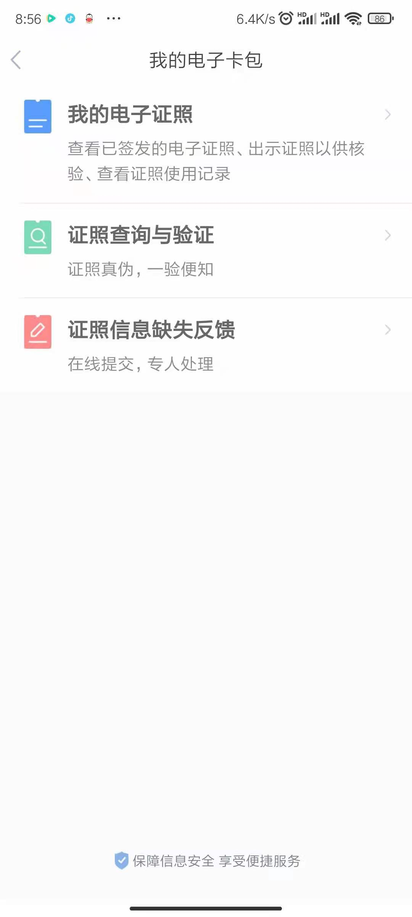
“亮证”培训

Slide 7
“亮证”培训

Slide 8
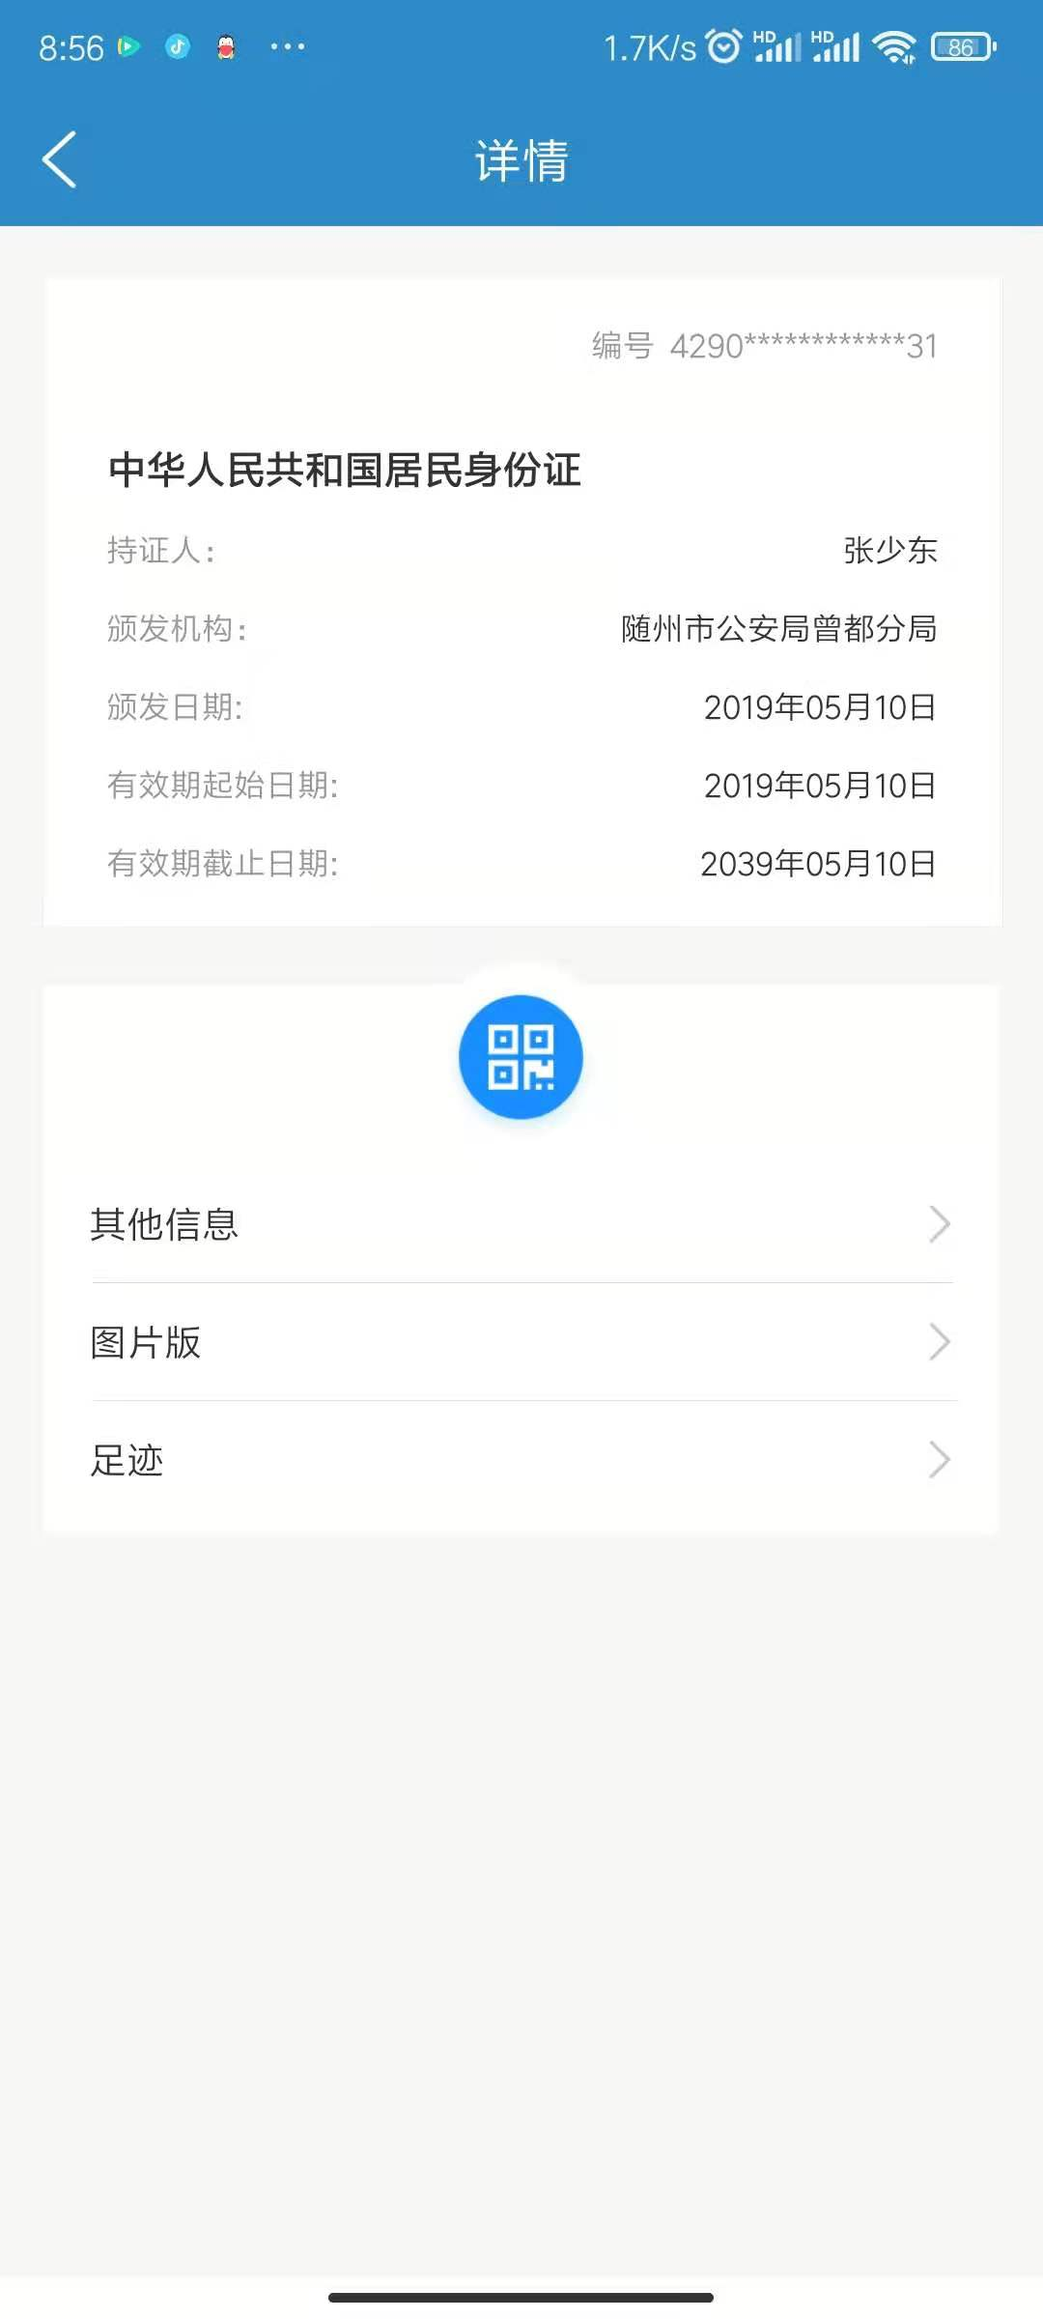
“亮证”培训

Slide 9
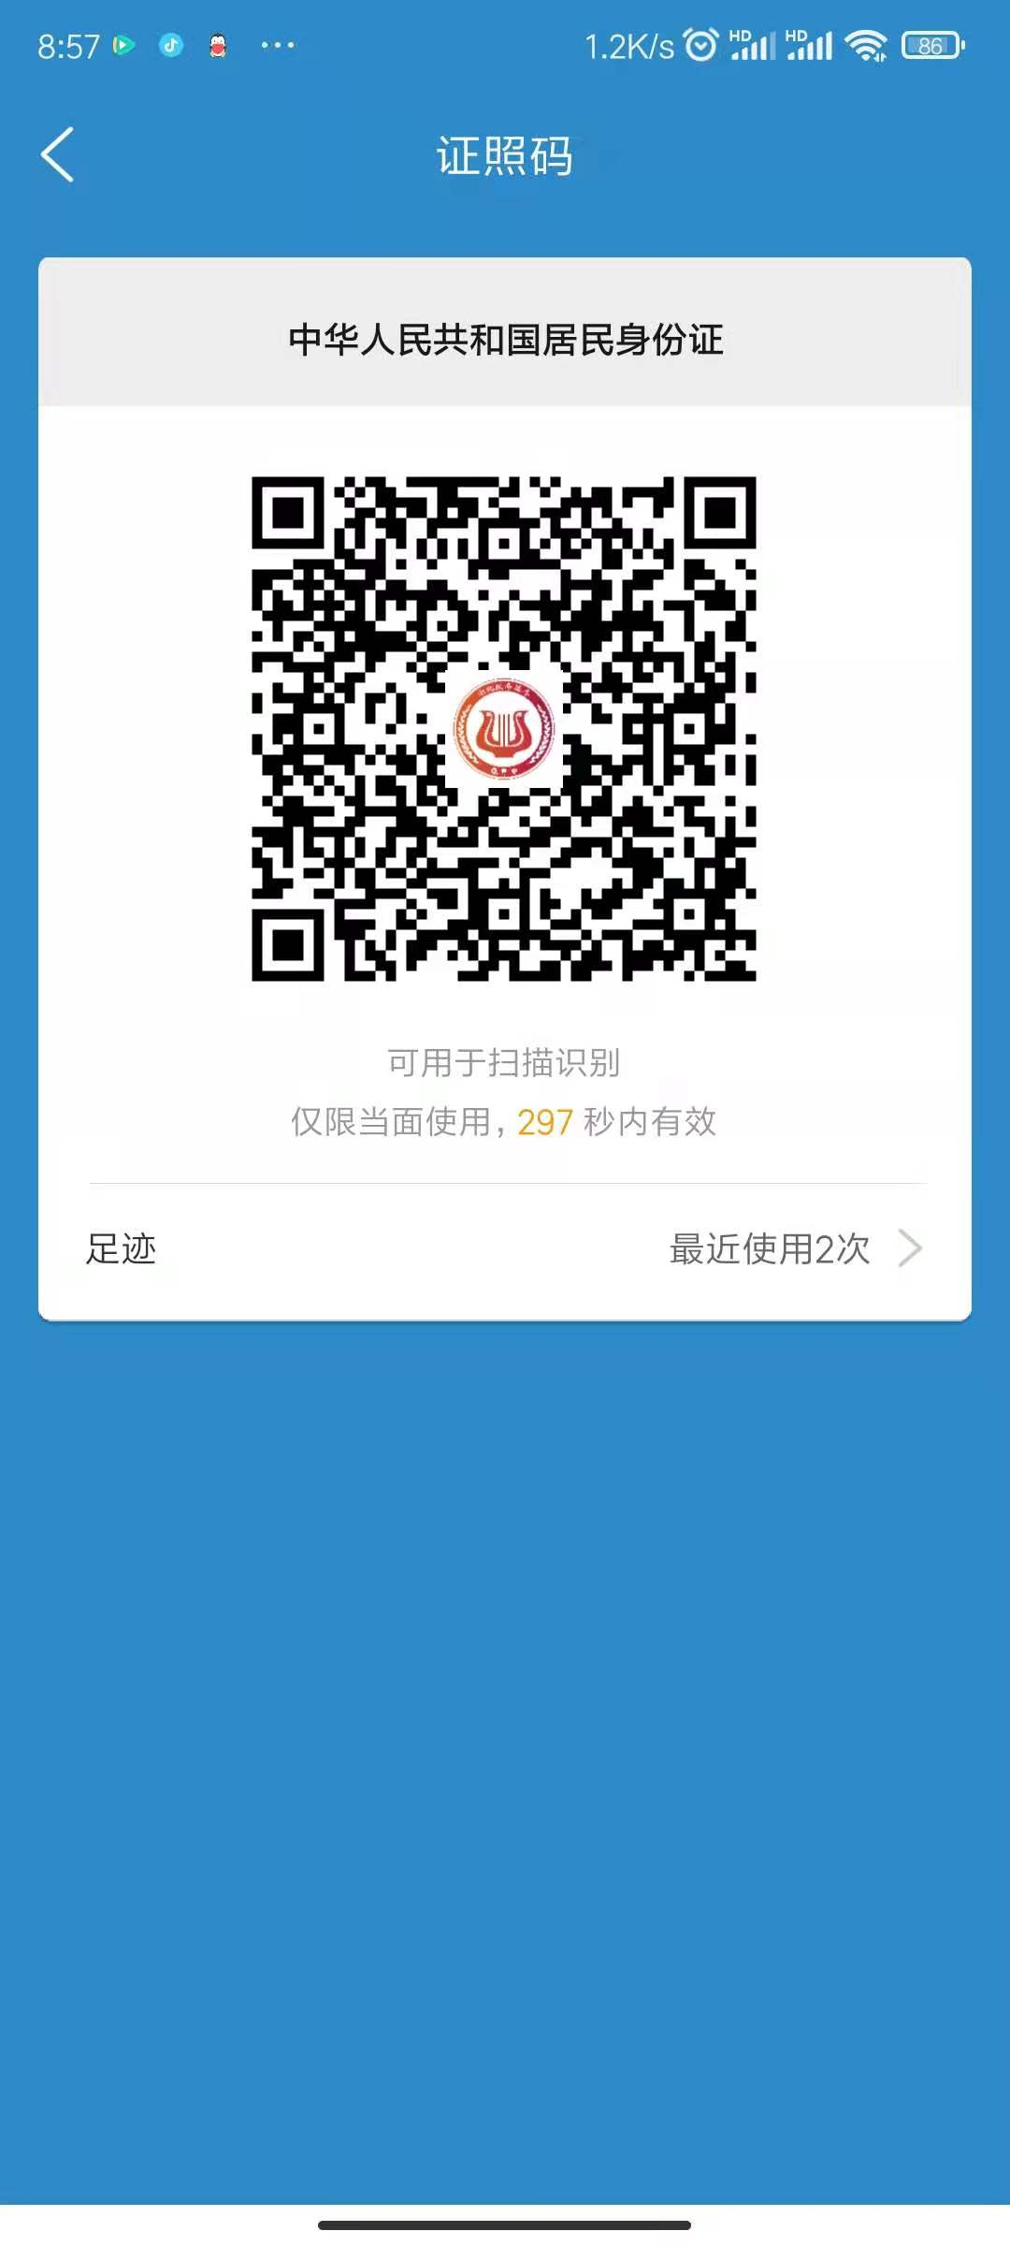
“亮证”培训

Slide 10
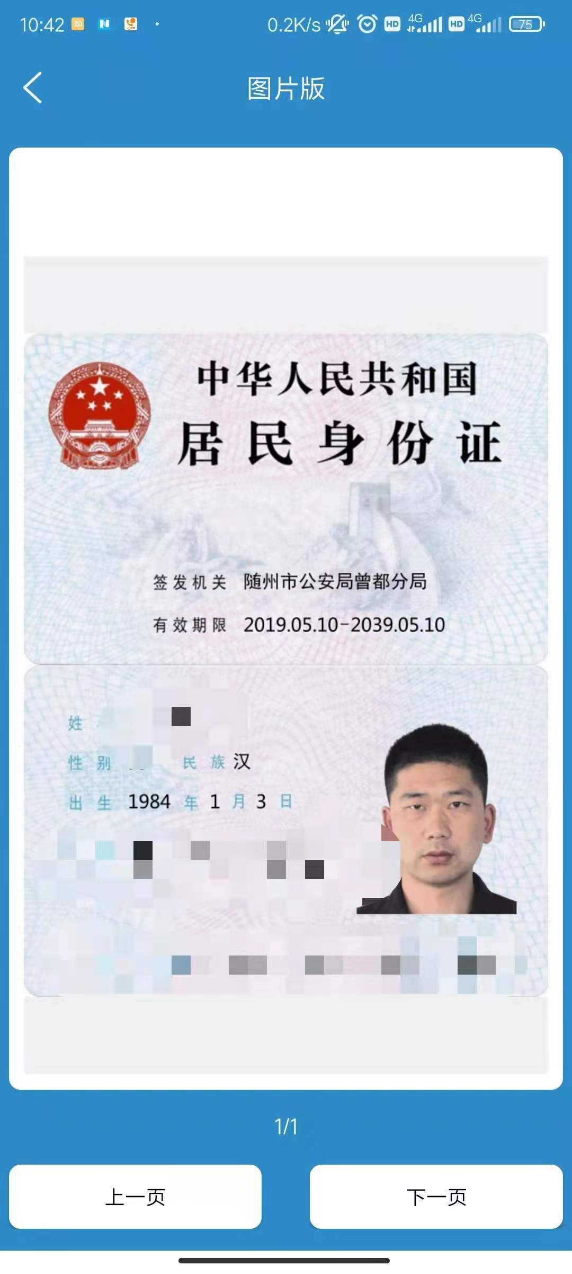
“亮证”培训

