Slide 1
电子证照调用流程

Slide 2
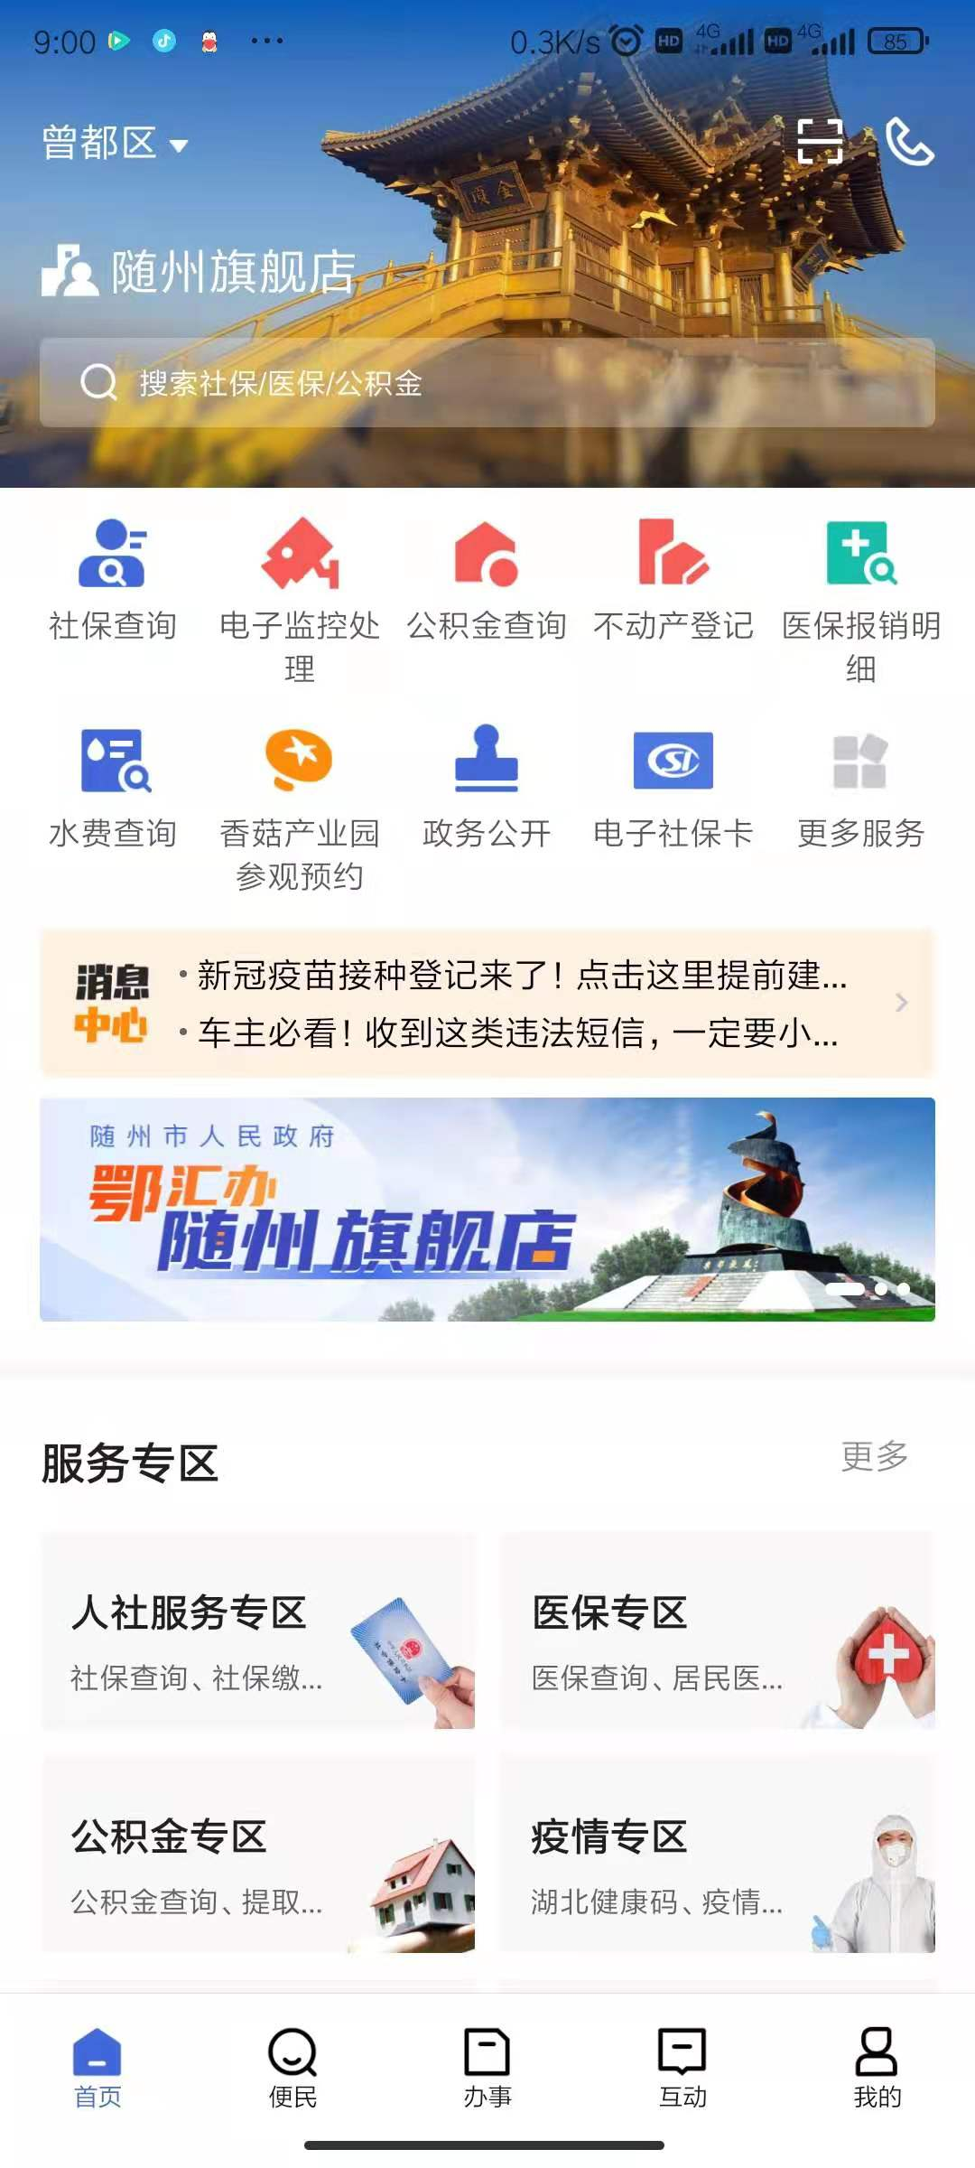
“亮证”培训

Slide 3
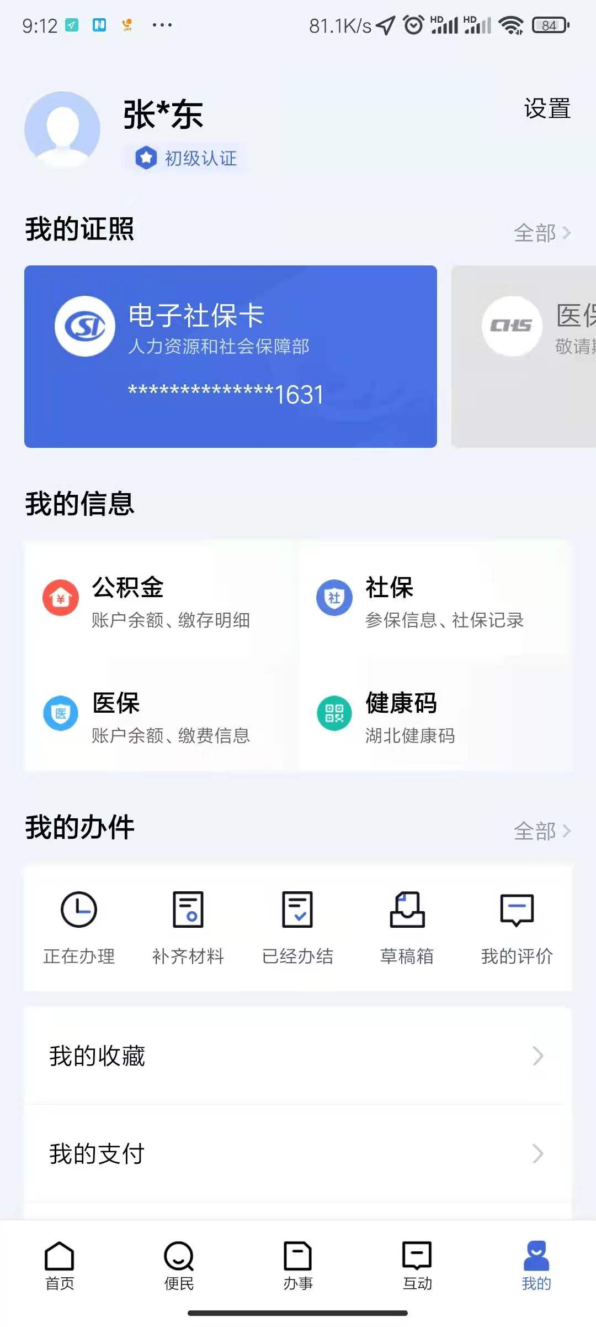
“亮证”培训

Slide 4
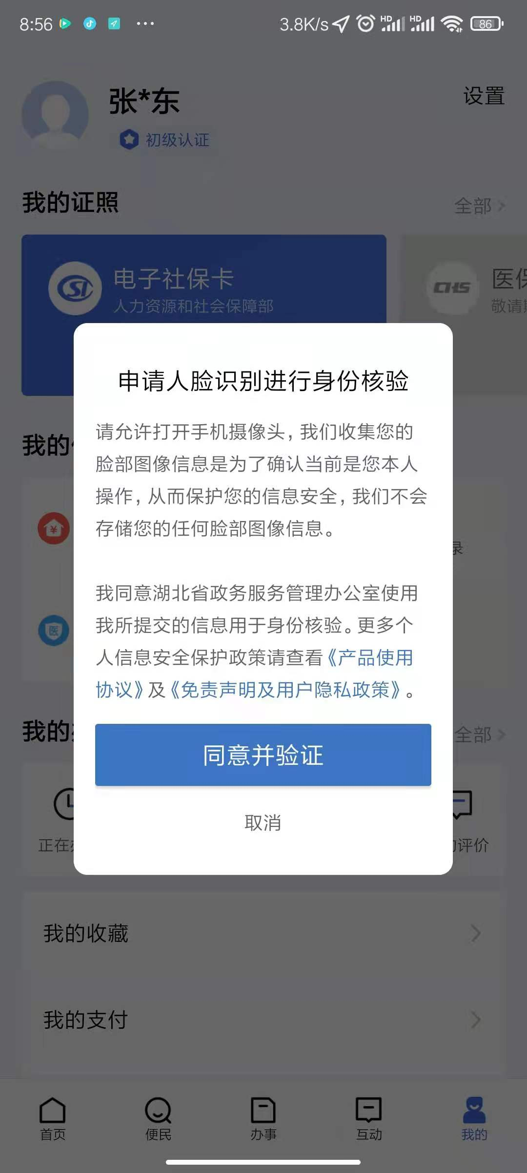
“亮证”培训

Slide 5

“亮证”培训

Slide 6
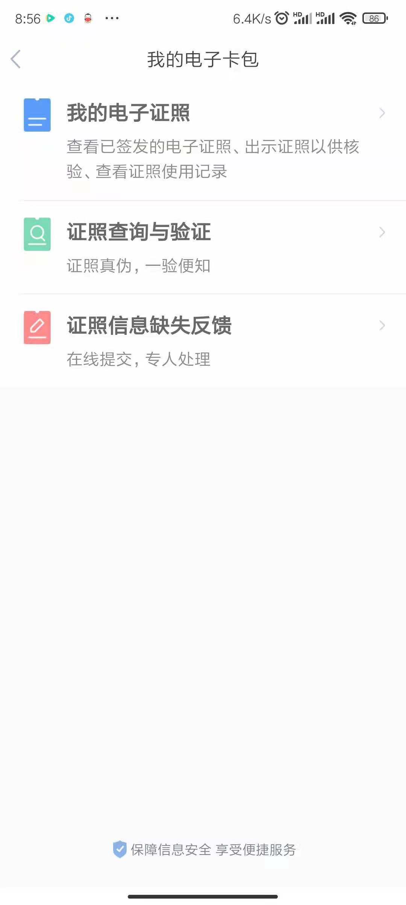
“亮证”培训

Slide 7
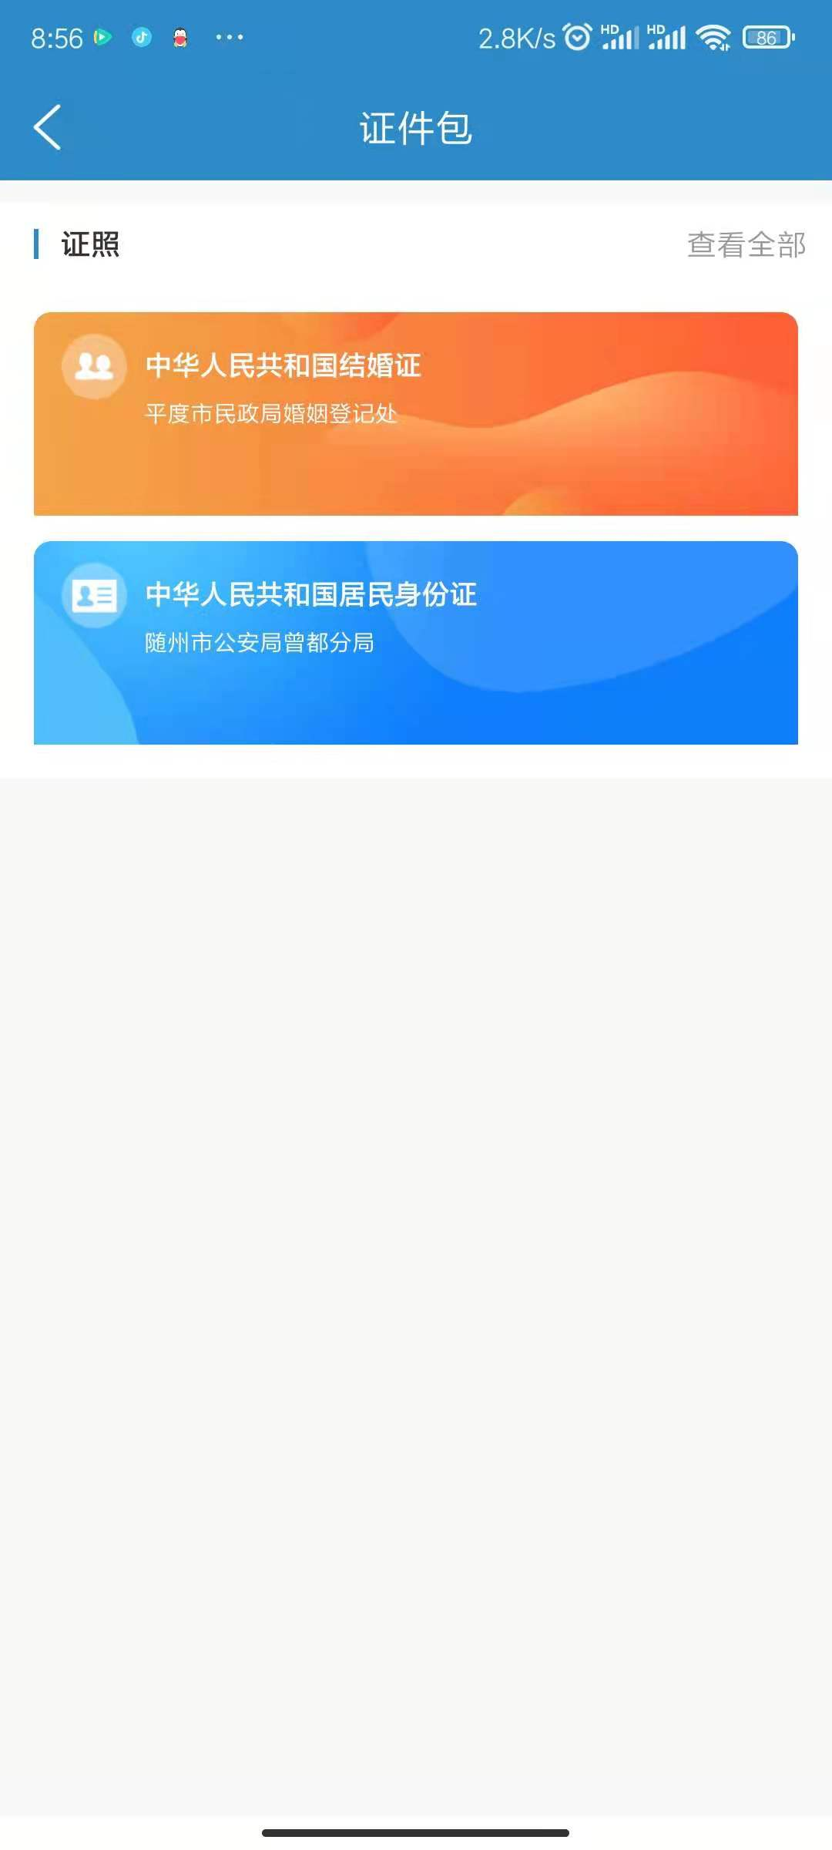
“亮证”培训

Slide 8
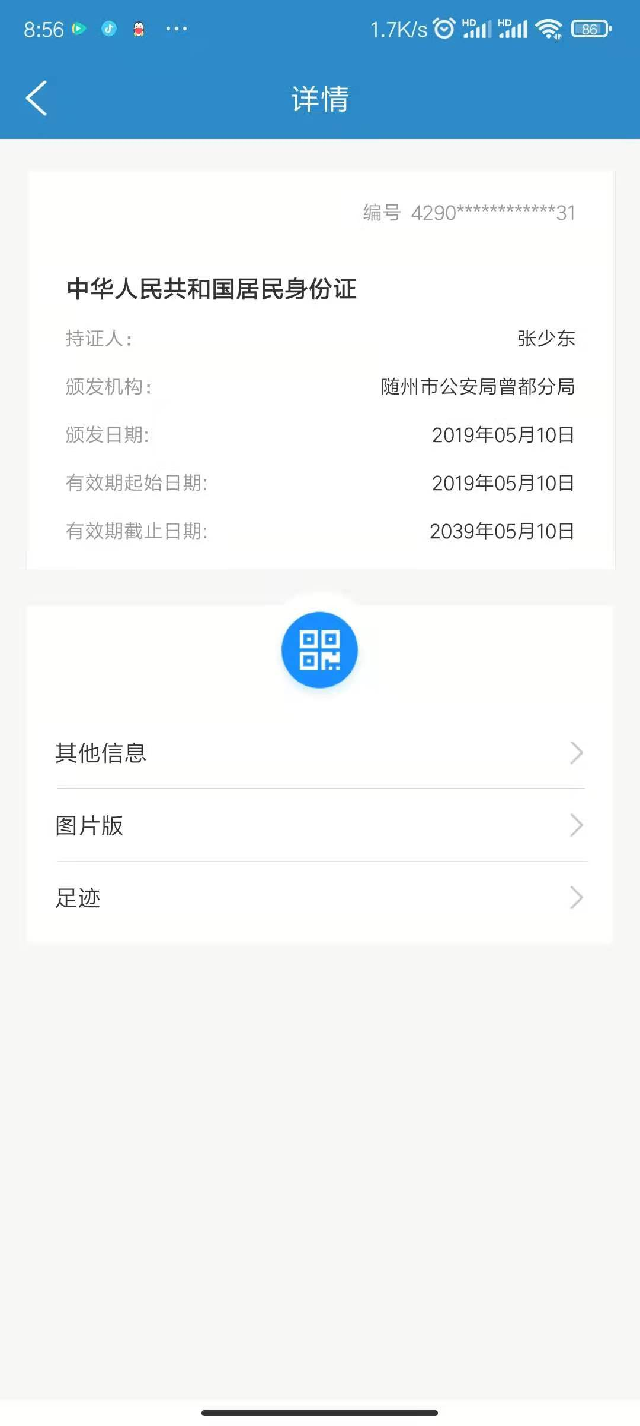
“亮证”培训

Slide 9
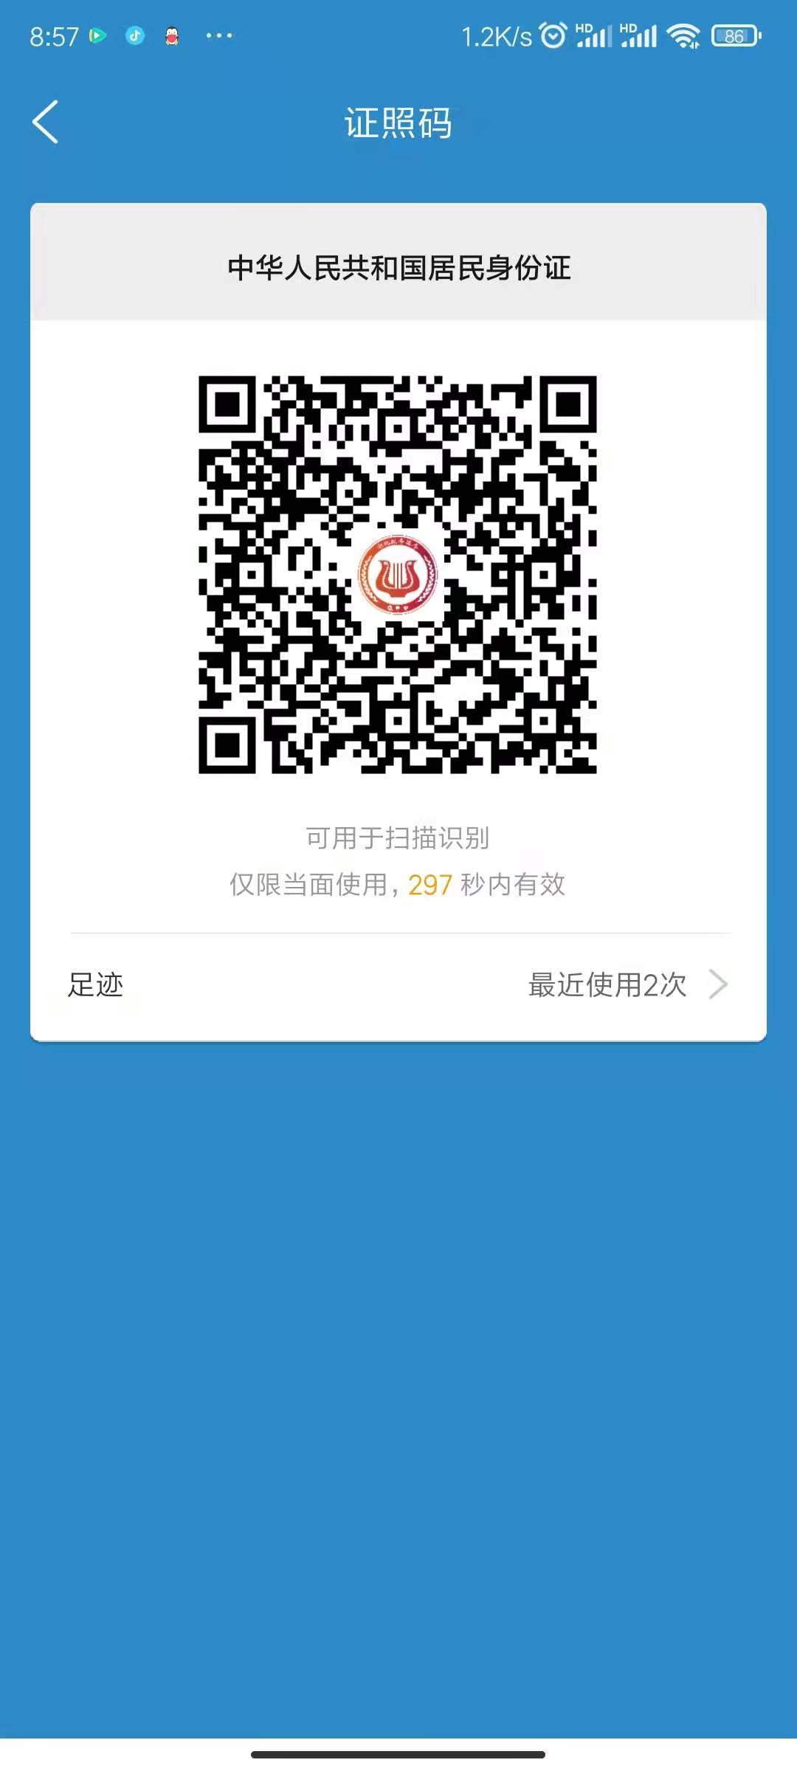
“亮证”培训

Slide 10
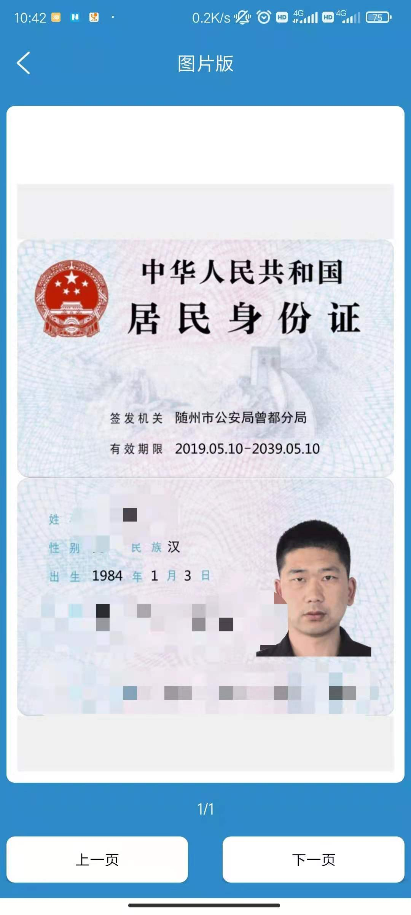
“亮证”培训

